Slide 1
Oracle Property Graphs Overview of available options
Witold Swierzy
Converged Database Specialist
July, 2024

Slide 2
Property Graphs
Data model, which puts a pressure on relationships between data
Often used on top of a relational schema
Provides specific methods of analyzing using edges as traversals between data
Path finding
Ranking and walking
Detecting and evaluating communities
Simplify solutions of some relational problems
”spaghetti” joins
Supported by all editions of Oracle Database in all deployment models
SE2, EE, Development/Express
Cloud and On-Premises
No separate license required
Person
Person
Person
Person
Person
Person
Person
knows
worksFor
Person
Company
name:Hugo

Slide 3
Property Graphs in Oracle Database
Three different query languages
PGQL
Supported in all versions of Oracle Database (19c, 21c, 23ai,..), Oracle Graph Server, Oracle Graph Studio for Autonomous Database, SQL Developer and SQL CL
Implemented in form of client libraries
Needs to be configured and enabled at the client level
Property graphs can be defined as data structures or views on top of data structures (recommended)
Documented here
SQL/PGQ
New feature of Oracle Database 23ai
Integral part of SQL, implemented at the database level
Available for all SQL clients, no need to configure anything
Supported also by Oracle Graph Server and Graph Studio
Property graphs are views on top of relational data structures
Documented here
GraphQL
Initially developed by Facebook/Meta as an API interface to Property Graphs
Implemented in Oracle REST Data Services component
Provides GraphQL support for REST calls
Documented here
Graph Model

Slide 4
Property Graphs in Oracle Database
Three different solutions
Oracle Database (all editions, all deployment models)
All versions support PGQL Property Graphs
SQL/PGQ and SQL property graphs are one of new features of Oracle Database 23ai
Graph Server and Graph Studio
Property Graph Analytic Layer
Graph Studio is integrated with Oracle Autonomous Database
Graph Server can be used with all editions of Oracle Database
Support PGQL and SQL/PG Property Graph
SQL/PGQ and SQL property graphs are supported when a tool is used with Oracle Database 23ai
Provide 60+ advanced, parallelized algorithms to analyze graph data
Java and Python interfaces
REST API is provided by Graph Server
Storage/cache layer for graph data
Oracle REST Data Services
REST API for SQL/PGQ, when used with Oracle Database 23ai
REST API for GraphQL
Graph Model

Slide 5
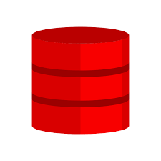
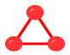
Scenario #1: Simple, single-layer architecture
Simple, single-layer architecture consisting of Oracle Database(s) only can be considered when
There is no need to use graph analytics layer provided by Oracle Graph Server/Oracle Graph Studio
For use cases, where operational property graphs with CRUD operations are used
If Oracle Database 23ai is used, or it is possible to upgrade the database to this version then SQL/PGQ and SQL property graphs are recommended
Note:
Property graphs are fully supported by all performance,
security and availability options
Graph Model

Slide 6
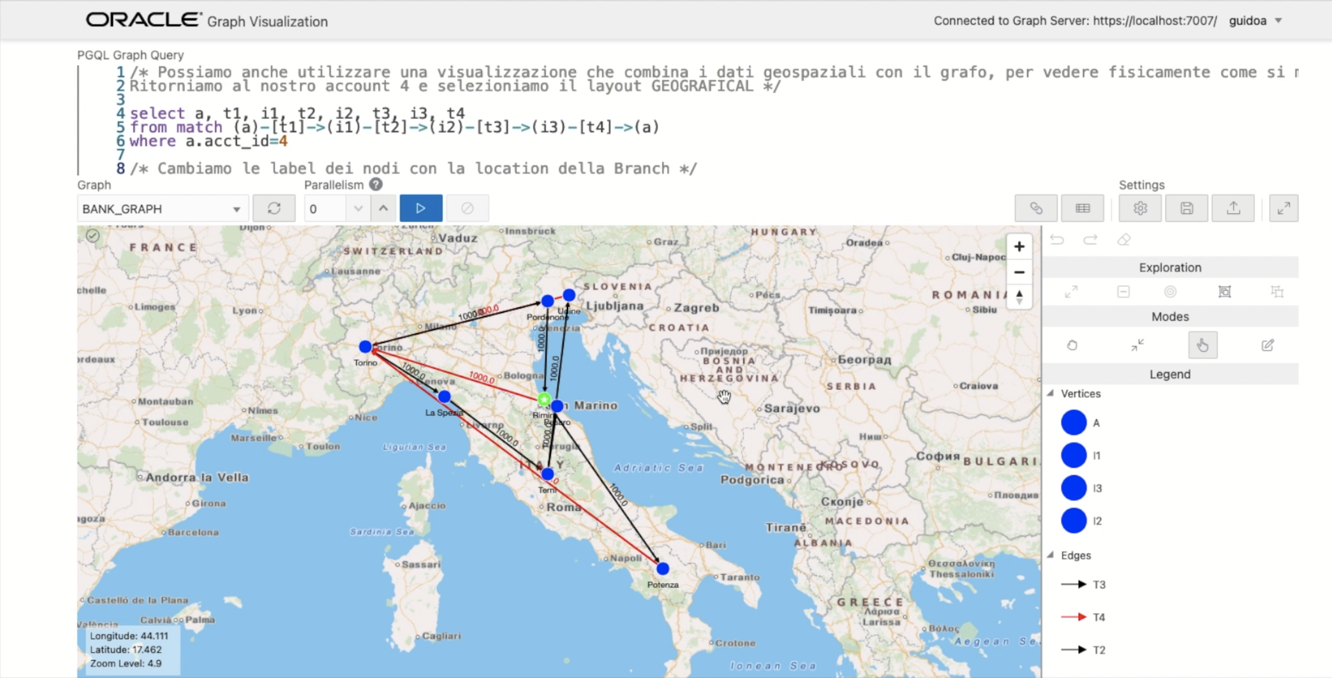
Scenario #2: Graph Server
Graph Server should be considered when
There is need to use advanced graph analytics, when a non-autonomous database is used
A separate storage/cache layer is considered as a way of distributing a heavy workload into different layers
There is need to use REST API to access PGQL graphs

Slide 7
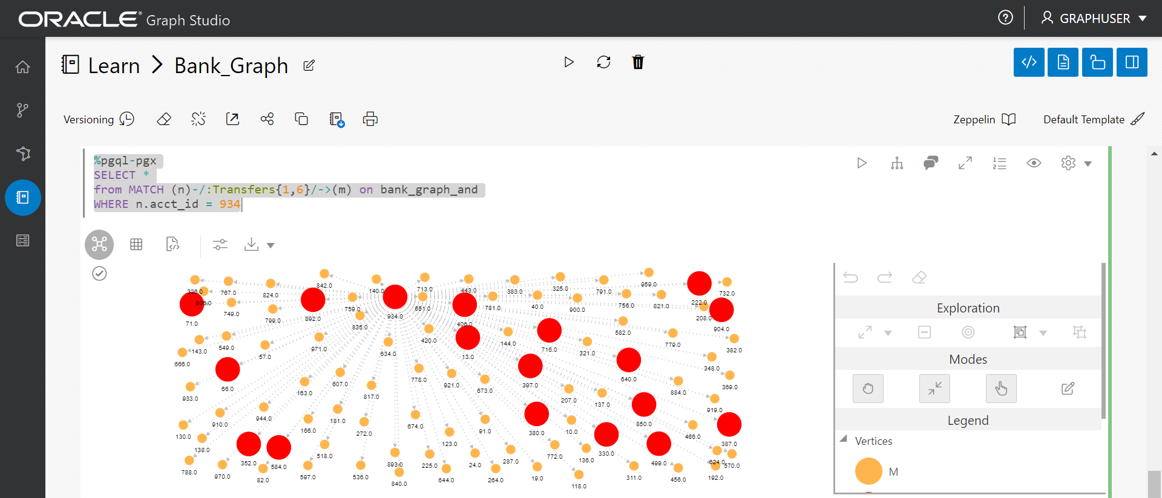
Scenario #3: Graph Studio
Graph Studio should be considered when
Oracle Autonomous Database is used
Advanced graph analytics layer is required
A separate storage/cache layer is considered as a way of distributing a heavy workload into different layers
There is no need to use REST API to access PGQL graphs

Slide 8

Scenario #4: ORDS with Oracle Database
ORDS with Oracle Database should be considered when
REST API is required for accessing SQL/PGQ and SQL property graphs in Oracle Database 23ai
There is need to use GraphQL and REST API to access the data
There is no need to use advanced analytics provided by Oracle Graph Server or Oracle Graph Studio
There is no need to use PGQL Property Graphs

Slide 9
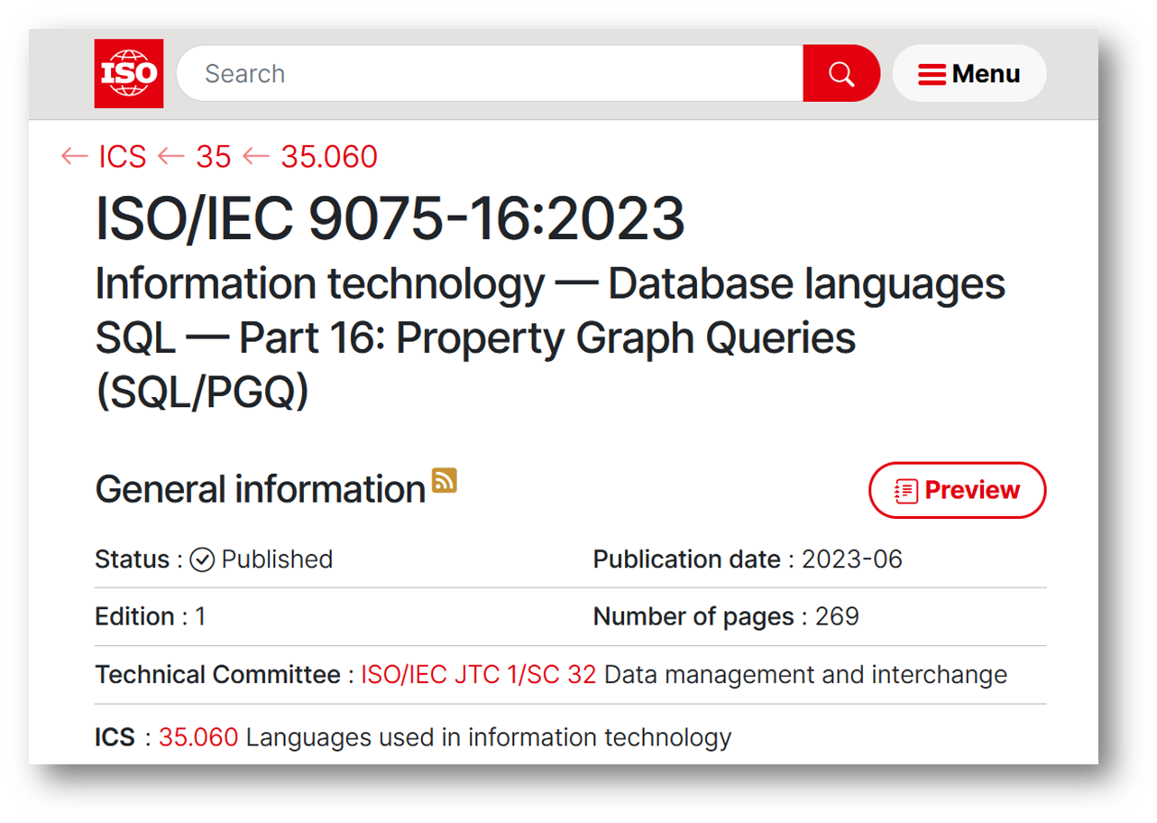
Oracle Database 23ai and SQL/PGQ
One of the most important new features in Oracle Database 23ai
Part of SQL 2023 ISO/IEC industry standard
Fully integrated with SQL, implemented at the database level
Immediate support for all SQL Oracle clients
Fully documented in data dictionary
SQL property graphs are implemented as views
No need to replicate the data
No performance overhead
Not all functionalities available yet
Advanced analytics will be implemented in future releases

Slide 10
Thank you

